Slide 1

MS-Copilot & PSR for screen capture
Cover design
These slide designs and messages are inspirational only. Please modify text boxes and positioning as needed based on the message and overall composition. Always consider the legibility and contrast of copy and content for maximum usability.
Any and all photography in these designs is given as an example. While you can use them, it’s better to change the photography to match your content.
To do so, right click on the picture or placeholder to change/insert a photo.
Where to find photography:
Photo library
Getty images (Recommended), Shutterstock, Adobe images (check with your M&C design team):
Further cover examples and inspiration are available in Extras file in your Powerpoint
-> File -> New from template…

Slide 2
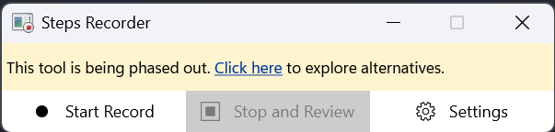
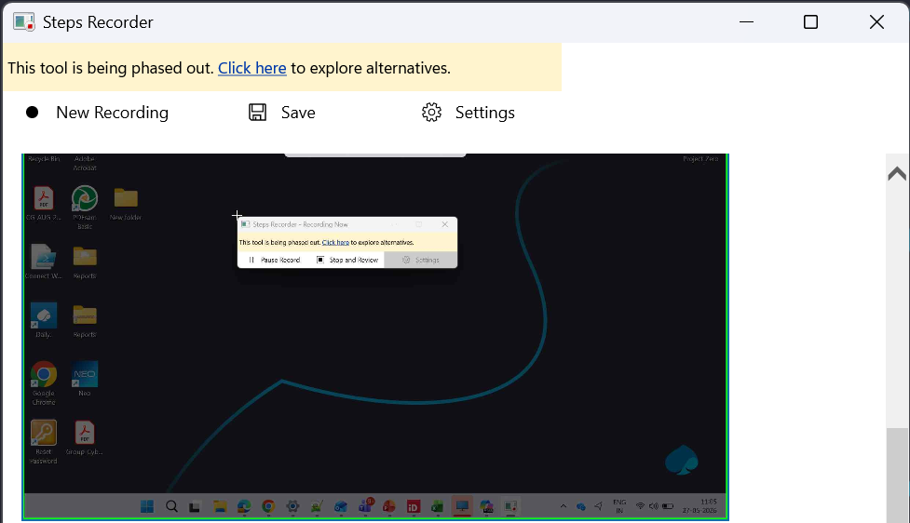
* Creating and Converting Screenshots with PSR and Copilot *
1. Open PSR Tool (psr.exe)
2. Click 'Start Record'
3. Perform actions you want to capture
4. Click 'Stop Record’​
5. Save the recorded file (.zip)​
6. Upload to Copilot​
Copilot Prompt: Analyze these PSR file and generate a clear step-by-step documentation.

Slide 3

Thank you.
Impact slides
These slide designs and messages are inspirational only. Please modify text boxes and positioning as needed based on the message and overall composition. Always consider the legibility and contrast of copy and content for maximum usability.
Any and all photography in these designs is given as an example. While you can use them, it’s better to change the photography to match your content.
To do so, right click on the picture or placeholder to change/insert a photo.
Where to find photography:
Photo library
Getty images (Recommended), Shutterstock, Adobe images (check with your M&C design team):
Further examples and inspiration are available in Extras file in your Powerpoint
-> File -> New from template…
Make it real.

